Slide 1
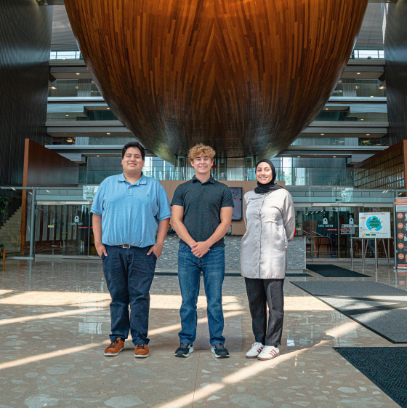
EI Software & Core Engineering: Summer Internship Projects
Charles Beck, Diego Gonzalez, and Zahra Berro

Slide 2



About Us
Charlie
Diego
Zahra
University of Michigan, Ann Arbor
Major: Computer Science
Department: EI Software
Manager: Hussain Darwish
Graduating Dec. 2026
Oakland University
Major: Computer Science
Dept: Core Engineering
Manager: Hector Robledo
Graduating Apr. 2026
University of Michigan, Dearborn
Major: Software Engineering
Department: EI Software
Manager: Hussain Darwish
Graduating Apr. 2026

Slide 3
About Us
Charlie
Diego
Zahra
University of Michigan, Ann Arbor
Major: Computer Science
Department: EI Software
Manager: Hussain Darwish
Graduating Dec. 2026
Oakland University
Major: Computer Science
Dept: Core Engineering
Manager: Hector Robledo
Graduating Apr. 2026
University of Michigan, Dearborn
Major: Software Engineering
Department: EI Software
Manager: Hussain Darwish
Graduating Apr. 2026

Slide 4
About Us
Charlie
Diego
Zahra
University of Michigan, Ann Arbor
Major: Computer Science
Department: EI Software
Manager: Hussain Darwish
Graduating Dec. 2026
Oakland University
Major: Computer Science
Dept: Core Engineering
Manager: Hector Robledo
Graduating Apr. 2026
University of Michigan, Dearborn
Major: Software Engineering
Department: EI Software
Manager: Hussain Darwish
Graduating Apr. 2026

Slide 5
Our Internship Overview: A Focus on Automation
Our Core Mission: To identify and solve challenges in engineering workflows through software automation.
Our Approach: We operated within an Agile/Scrum framework, using sprints and daily stand-ups to manage our work and collaborate effectively.
Our Projects: Today, we'll present four key projects that highlight our contributions:
Static Code Analysis
Automated Time Reporting
Outlook to Windchill Integration
PDF to SOV Automation

Slide 6
Our approach: working with agile & scrum
Our Framework: To guide our work and ensure success, our team adopted the Agile Scrum framework, a standard in modern software development.
Our Process Included:
Sprints: We organized our work into focused cycles, allowing us to deliver value incrementally.
Daily Scrums: These daily check-ins kept us synchronized, aligned, and helped us quickly resolve any roadblocks.
Sprint Demos & Retrospectives: Regular demos to our manager ensured we were on the right track, while retrospectives helped us continuously improve our teamwork and processes.
Why This Mattered:
This structured approach provided the clarity and organization needed to tackle multiple complex projects simultaneously.
It fostered constant communication and a collaborative team environment.

Slide 7
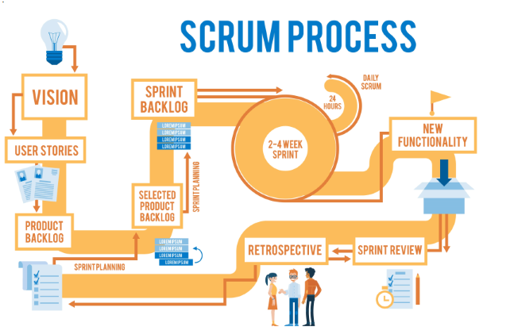
Applying the Agile framework to manage multiple complex projects and deliver consistent value.

Slide 8
Automating Compliance Tracking
Parsing, Tracking and Storing Compliance Data with QAVerify Reports

Slide 9

Qav/qac overview
What is QAC/QAV?
How do we track code compliance over time?
Are we improving from one baseline to the next?
Why does this take so long to trace manually?

Slide 10
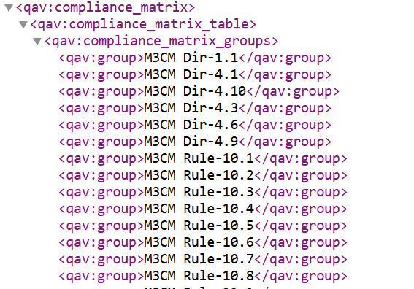
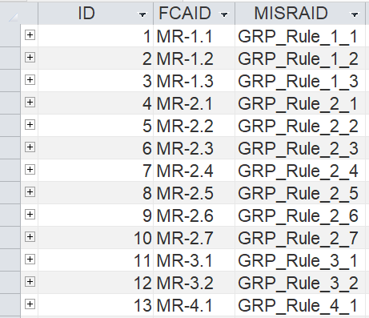
Project goal
Automate the process of parsing QAVerify XML reports and populating a centralized Microsoft Access database.

Slide 11
Project goal
Automate the process of parsing QAVerify XML reports and populating a centralized Microsoft Access database.

Slide 12
How Did we go about this:
Generate XML Files

Slide 13
How Did we go about this:
Generate XML Files
Analyze the Data

Slide 14
How Did we go about this:
Generate XML Files
Analyze the Data
Design Database

Slide 15
How Did we go about this:
Generate XML Files
Analyze the Data
Design Database
C++ Parser

Slide 16
How Did we go about this:
Generate XML Files
Analyze the Data
Design Database
C++ Parser
Mapping

Slide 17
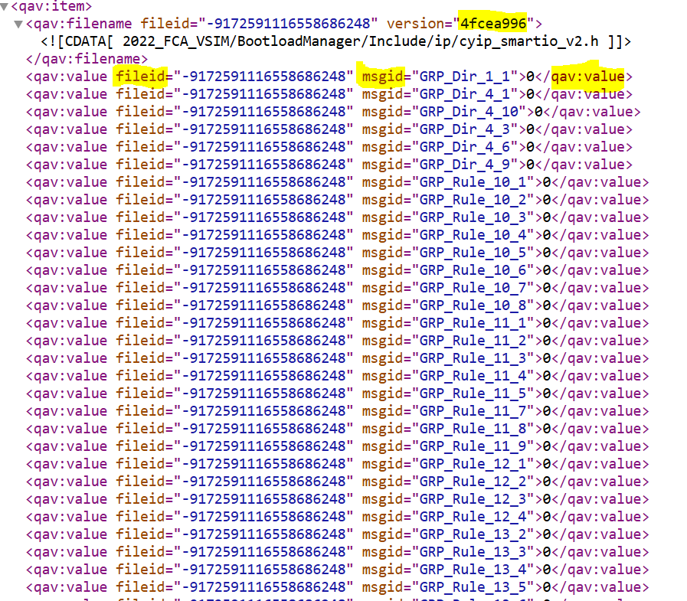
Step 1: Exported and analyzed XML reports
Identified useful report types:
Compliance Matrix – for active violations
Suppression Deviation List – for suppressed violations
Ensured consistent format across multiple baselines for traceability
Analyzed report structure to identify trackable fields (widgets, baselines, deviations)

Slide 18
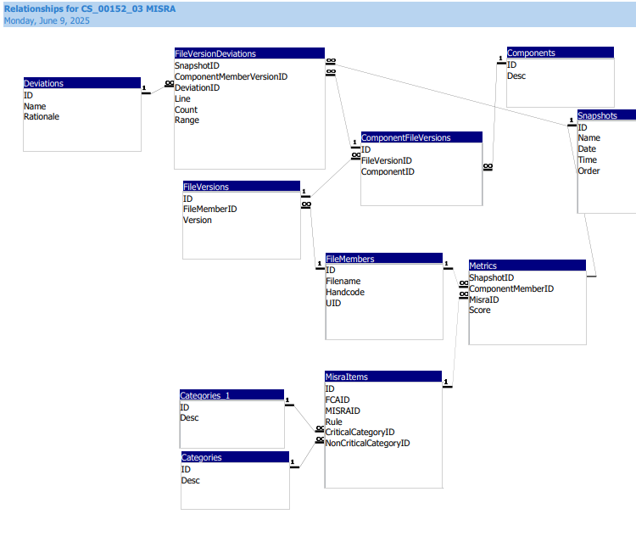
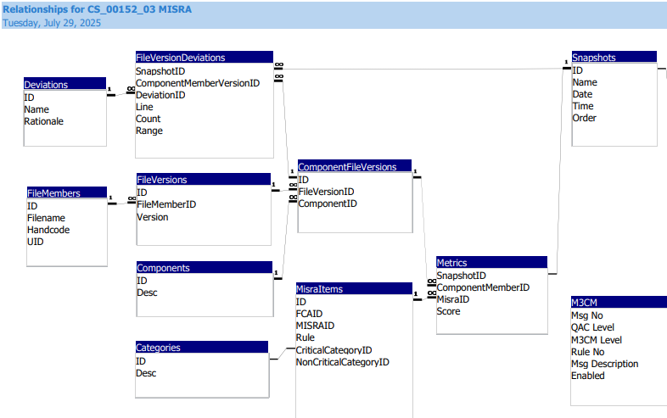
Step 2: redesigned Relational Database Schema
Before:
After:
Redesigning the database schema to enable version tracking and historical compliance analysis.

Slide 19
Step 2: redesigned Relational Database Schema
Before:
After:
Redesigning the database schema to enable version tracking and historical compliance analysis.

Slide 20
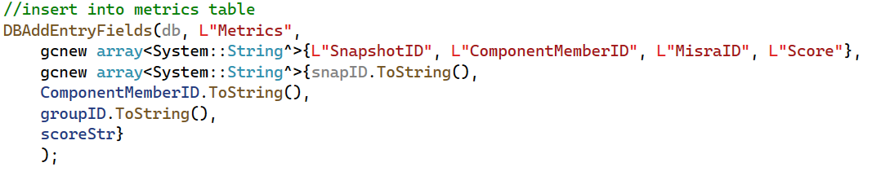
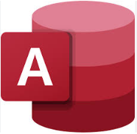

Step 3: Populated Tables via C++ Integration
Objective:
Automate the insertion of extracted QAV data into the redesigned Microsoft Access database.
Tools Used:
Language: C++
IDE: Visual Studio
Database: Microsoft Access (.mdb)

Slide 21
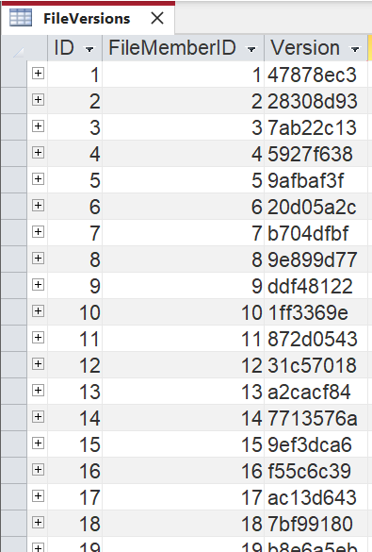
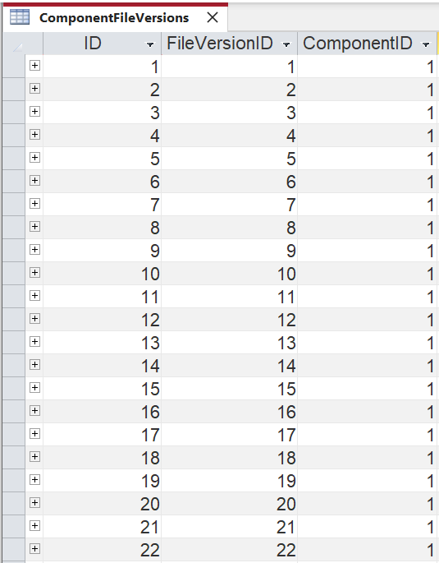
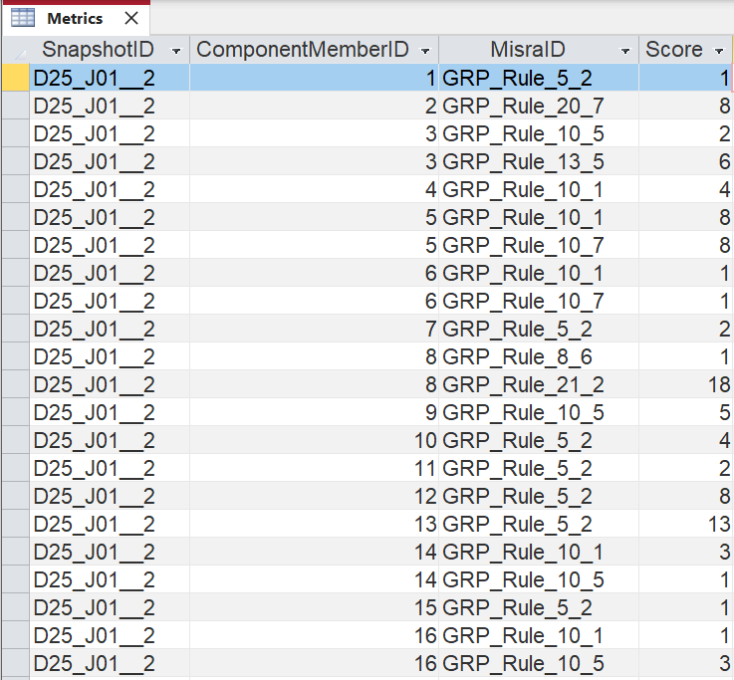
The Result: An Automated Data Pipeline
Version Tracking
Creating a fully linked data structure to enable powerful, specific compliance queries.

Slide 22
The Result: An Automated Data Pipeline
Version Tracking
Foreign key
Foreign key
Creating a fully linked data structure to enable powerful, specific compliance queries.

Slide 23
The Result: An Automated Data Pipeline
Version Tracking
Foreign key
Foreign key
Creating a fully linked data structure to enable powerful, specific compliance queries.

Slide 24
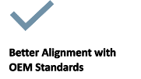


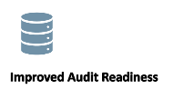

The Impact: Visibility & Audit Readiness
Centralized database improves audit readiness and traceability.
Automation reduces manual reporting time and effort.
Enhanced visibility into code quality across versions.
Strengthens compliance with OEM standards like MISRA.
Scalable design enables future integration and automation.

Slide 25
Streamlining Meeting Documentation
Connecting Outlook to Windchill

Slide 26
Outlook -> Windchill Overview
Currently meetings must be manually created twice.

Slide 27
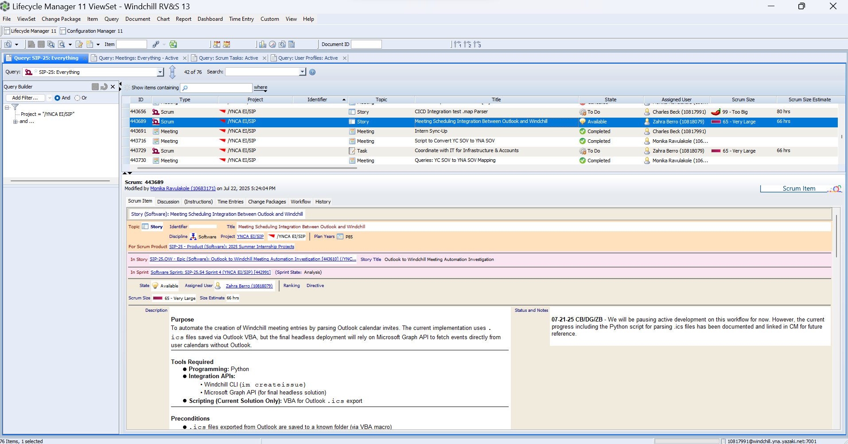
Outlook -> windchill overview
What is Windchill?

Slide 28
Outlook -> windchill overview
What is Windchill?
How can we gather meetings from Outlook?

Slide 29
How can we gather meetings from Outlook?
Microsoft Graph
Pros:
● Supports headless execution
● Supports M365
Win32 API
Pros:
● Simple implantation & testing
●Native .ics support
●No outside connection
Cons:
● No Microsoft Support
● No built-in ICS generation
● Not truly headless
Cons:
● Complex Setup
● No built-in ICS generation
● Requires Asure

Slide 30
How can we gather meetings from Outlook?
Microsoft Graph
Pros:
● Supports headless execution
● Supports M365
Win32 API
Pros:
● Simple implementation & testing
●Native .ics support
●No outside connection
Cons:
● No Microsoft Support
● Not truly headless
Cons:
● Complex Setup
● No built-in .ics generation
● Requires Azure

Slide 31




Microsoft Graph Vs Win32
Microsoft Graph
An app is registered is Microsoft Azure Studio, to get access tokens.
Using the access tokens from Azure Studio & the Graph API the script access the outlook calendar.
The information is then manual parsed into a
.ics file for easy reading.
The .ics file is then places into a folder for further processing.

Slide 32
Outlook -> windchill overview
Now that we know how to gather the meetings, how can we put them in Windchill?

Slide 33
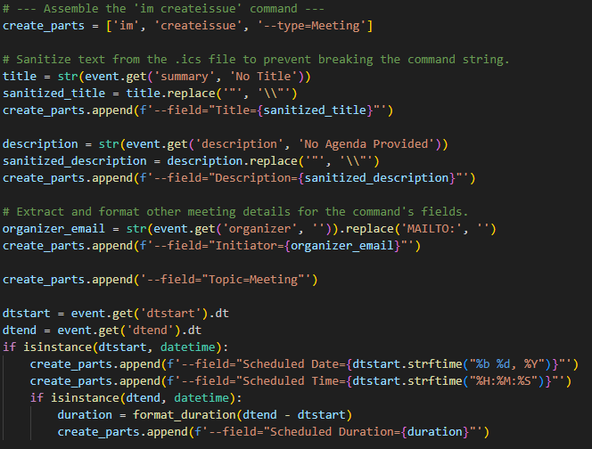
Outlook -> windchill overview
Now that we know how to gather the meetings, how can we put them in Windchill?
A little birdie

Slide 34
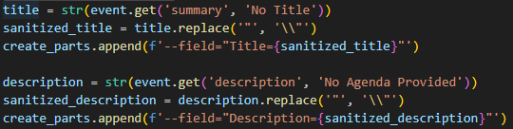
Outlook -> windchill overview
Now that we know how to gather the meetings, how can we put them in Windchill?
A little birdie
What are we doing here?

Slide 35
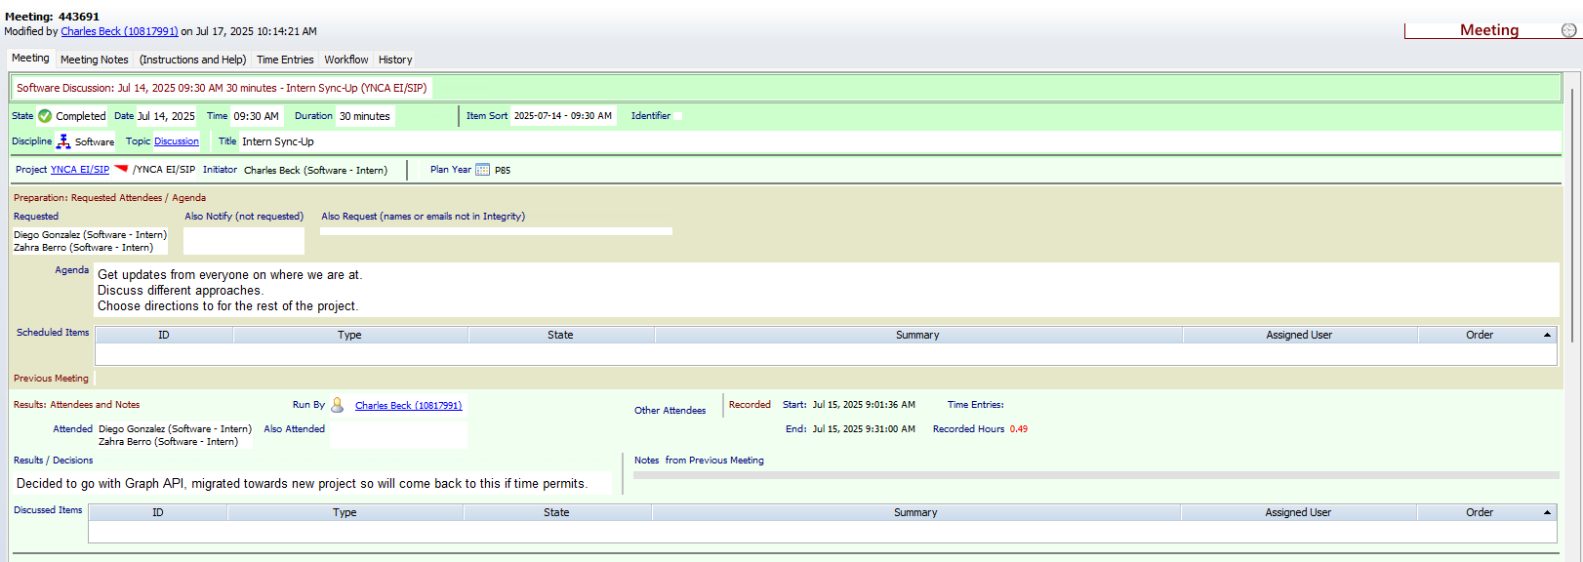
Results
Automating the creation of auditable Windchill meeting records directly from Outlook invites.

Slide 36
Impact
Save Time
Reduce Errors
More compliant
Boosts Engineering Productivity by eliminating a repetitive, manual documentation task for every scheduled meeting.
Improves Data Accuracy & Consistency by removing the risk of human error from manual data entry into Windchill.
Ensures Full Documentation Compliance by creating a complete and auditable trail of all project meetings in the official system of record.

Slide 37
Automating YC sovs To yna Sovs
Processing pdfs and converting them to Excel spreadsheets

Slide 38
YC SoV -> Yna SOV Overview
YC SOVs must be converted into YNA SOVs

Slide 39
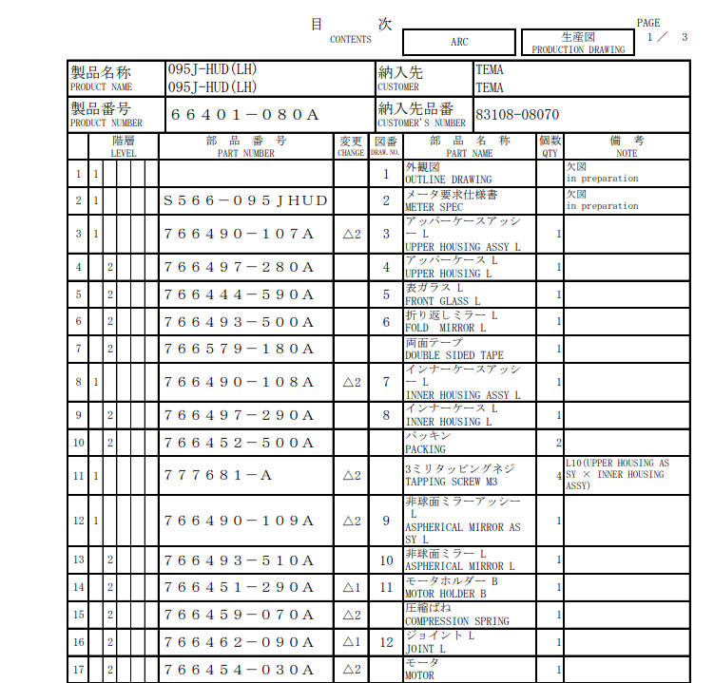
YC SoV -> Yna SOV Overview
YC SOVs must be converted into YNA SOVs
What is a SOV?

Slide 40
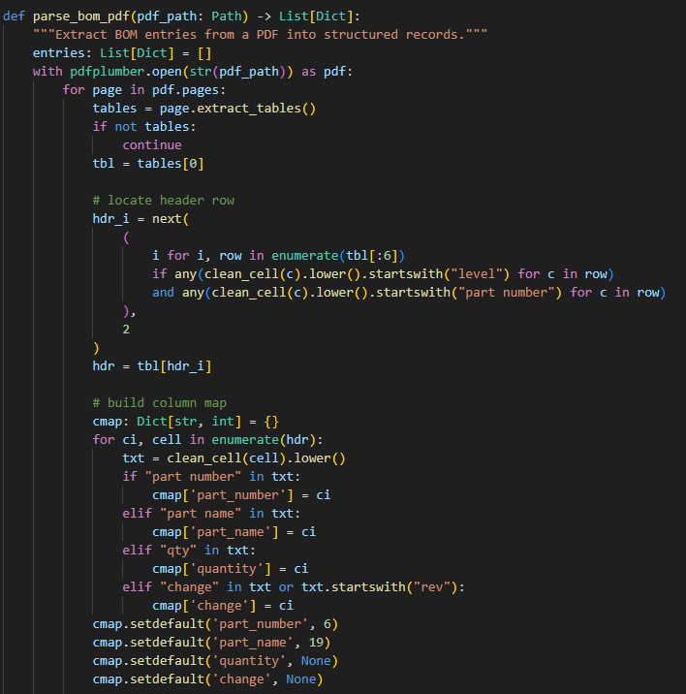
YC SoV -> Yna SOV Overview
YC SOVs must be converted into YNA SOVs
What is a SOV?
How can we make that into an SOV?

Slide 41
YC SoV -> Yna SOV Overview
YC SOVs must be converted into YNA SOVs
What is a SOV?
How can we make that into an SOV?
What does the new SOV look like with this code?

Slide 42
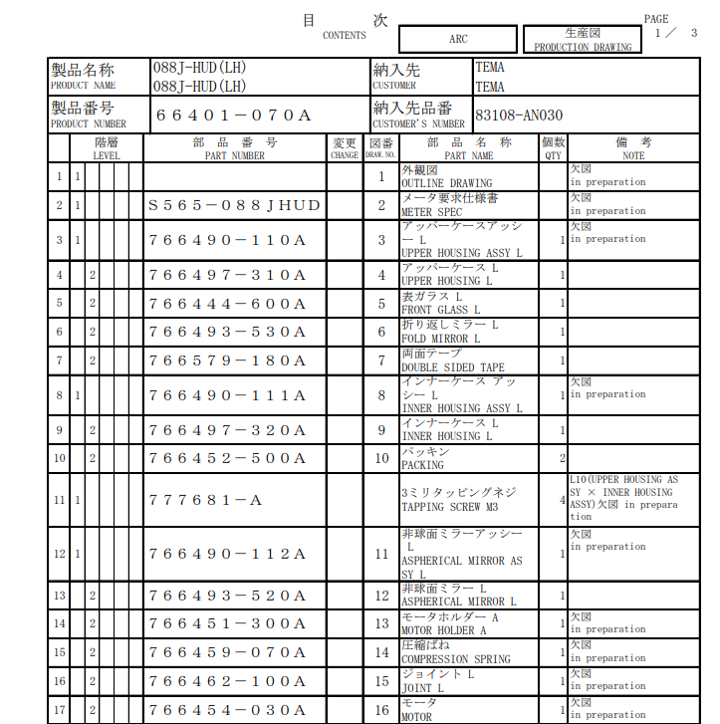
Before
With these two SOV PDFs…

Slide 43
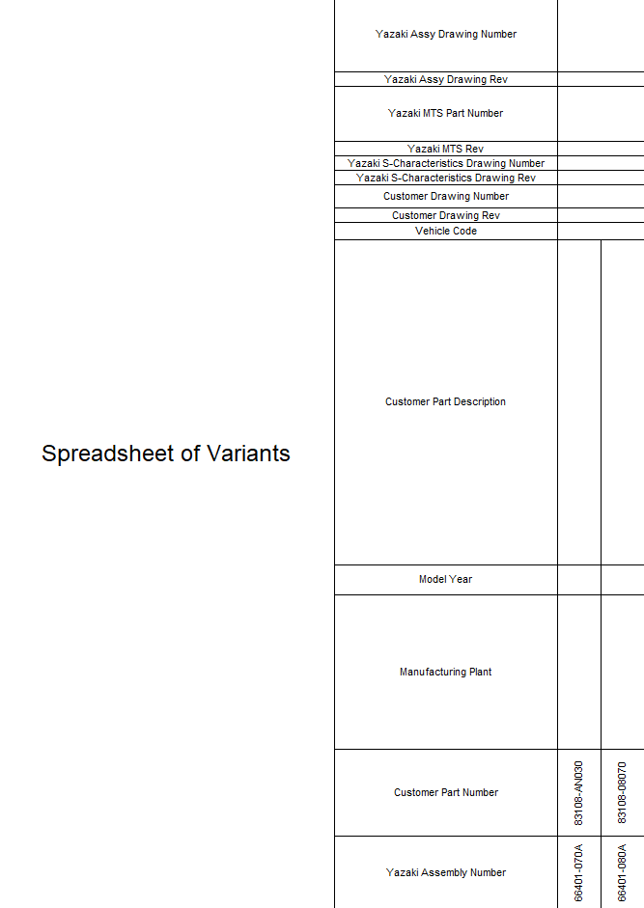
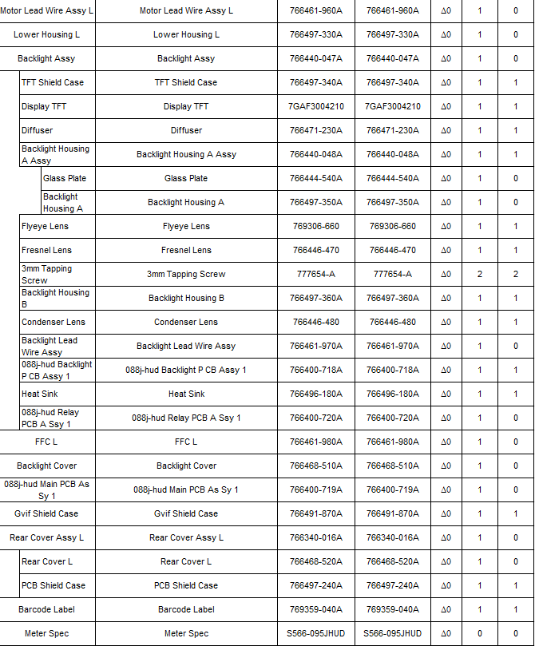
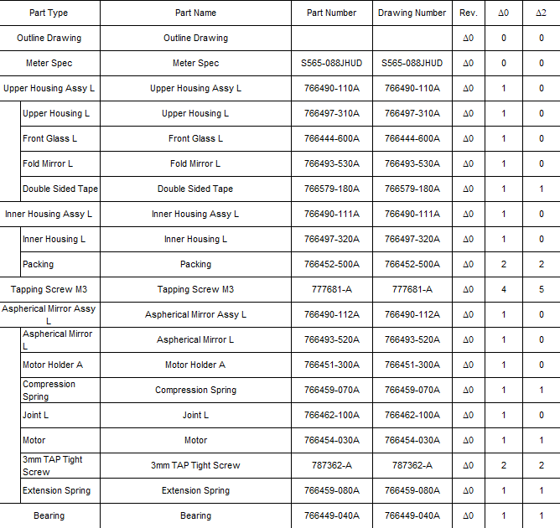
After
We get an elegant spreadsheet of all SOV variants
Consolidating multiple, disparate PDF SOVs into a single, structured source of truth.

Slide 44
Pivoting our approach for a simpler solution
Our Final, More Efficient Solution
Our Initial Plan
PDF File
PDF File
Python Parser
Database (SQLite)
Python Script with pandas
SQL Query
Python Script
Excel SOV
Excel SOV

Slide 45
Impact
Time savings
Reduce Errors
Process Acceleration
Replaced hours of tedious manual labor with a solution that runs in seconds.
Guarantees data integrity and eliminates the risk of costly transcription errors in the SOV.
Streamlines a critical workflow, enabling faster project turnaround and quicker handoffs to downstream teams.

Slide 46
Time Threshold reporting
Uncovering time-reporting gaps to boost accountability, visibility, and compliance.

Slide 47
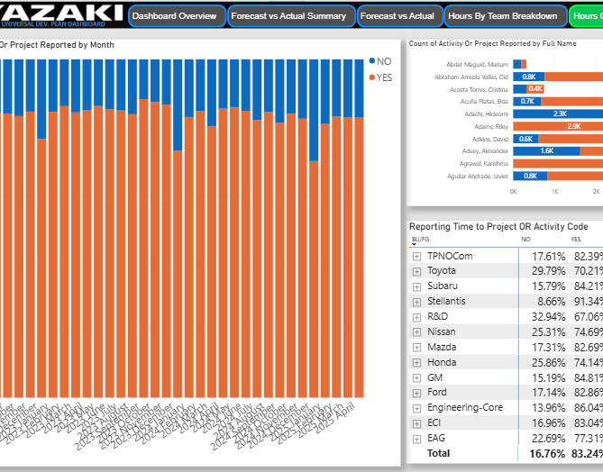
Time reporting threshold
Purpose:
Gain a better understanding of actual resource requirements to develop different products/complete projects
Accurate reporting is required for a proper R&D tax credit of engineering resources
Hours are assigned Development plans can used to invoice Yazaki affiliates
Action:
Create program that flags users who don’t properly report time, and than sends an email to users & their manager/director.
20% of hours show no activity and project reported each month!

Slide 48
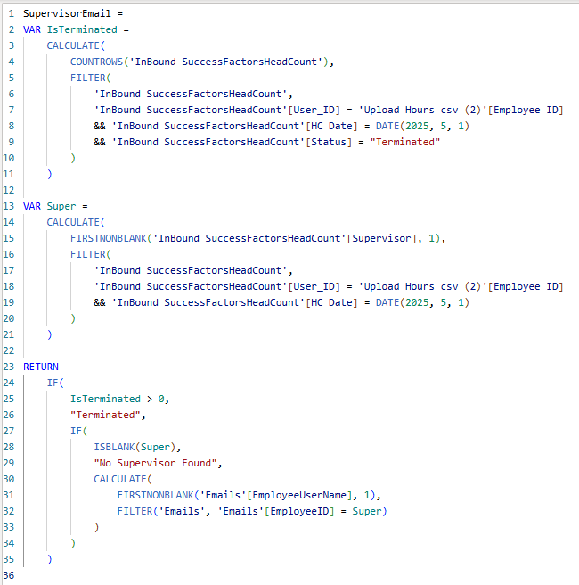
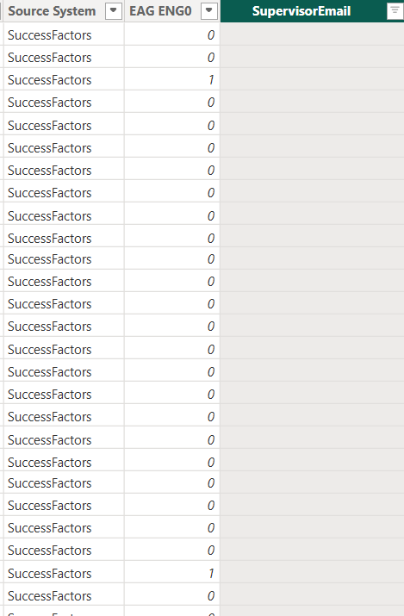
Step 1: update the udp dashboard
New cell in the upload hours table
Query to populate the Supervisor Email
cell

Slide 49
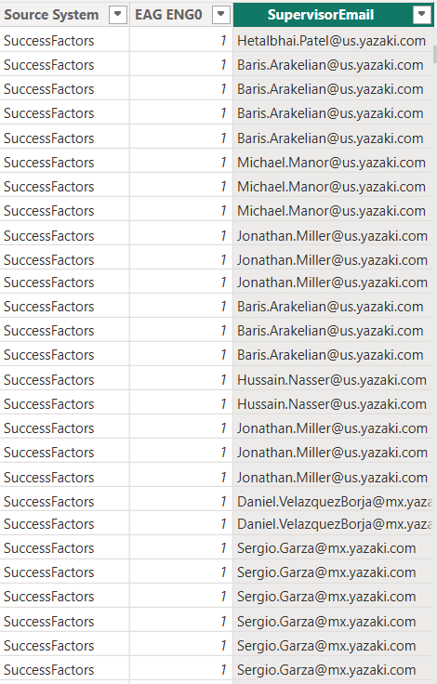
Step 1: update the udp dashboard
Populated cells
Query to populate the Supervisor Email
cell
New cell in the upload hours table

Slide 50

Step 1: update the udp dashboard
Query to populate the Supervisor Email
cell
New cell in the upload hours table
Populated cells
Power BI Query
Parse into a Json file
Send out Emails
Monthly
recurrence

Slide 51
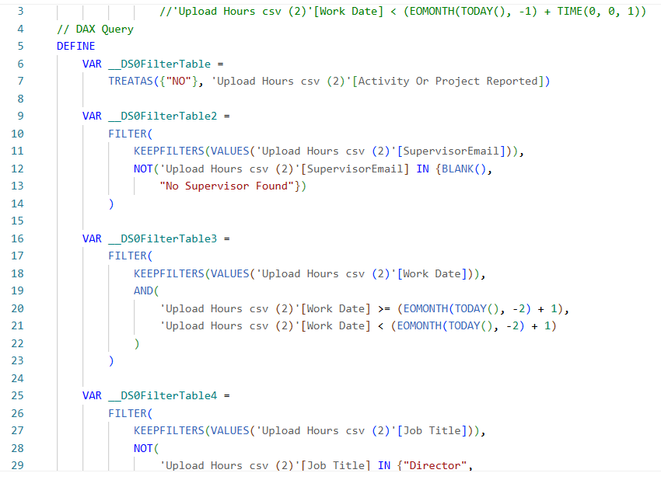
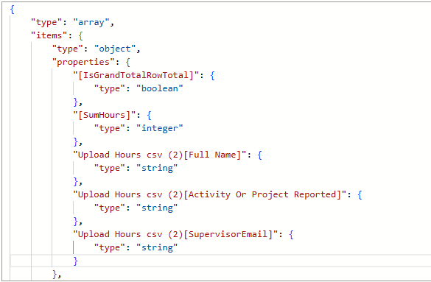
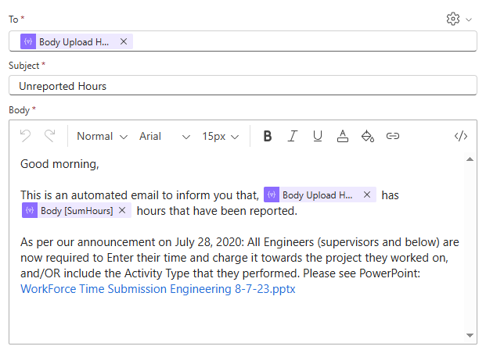
Step 2: The power of Automation
Query to populate the Supervisor Email
cell
New cell in the upload hours
Populated cells
Power BI Query
Parse into a Json file
Send out Emails
Monthly
recurrence

Slide 52
Step 2: The power of Automation
Power BI Query
Parse into a Json file
Send out Emails
Monthly
recurrence

Slide 53
Step 2: The power of Automation
Power BI Query
Parse into a Json file
Send out Emails
Monthly
recurrence

Slide 54
Step 2: The power of Automation
Power BI Query
Parse into a Json file
Send out Emails
Monthly
recurrence

Slide 55
Impact
Active feedback
BETTER VISIBILITY
ORGANIZED Governance
This flow will give leadership more accurate visibility into how resources are used across different products and projects.
Automated monthly notifications and standardized tracking promote company-wide consistency and strengthen compliance.

Slide 56
Our Key Lessons Learned
Success is More Than Code: It's Understanding the Business Problem.
We learned that the most impactful solutions come from deeply understanding the "why" behind a task—whether it's saving an engineer's time or ensuring compliance for an audit.
The Power of Collaboration: Agile, Feedback, and Iteration.
Our Agile process taught us that consistent communication and feedback are essential. Great ideas came from our daily stand-ups and sprint demos, not just from working alone.
Clarity is a Skill: Translating Technical Solutions into Business Value.
It's not enough to build a functional tool. We learned the crucial skill of explaining how our technical work solves a business problem, saves money, or reduces risk.

Slide 57
Valuable experience, lasting impact
From Academic Concepts to Real-World Application:
This internship allowed us to apply our classroom knowledge to solve complex, "messy" business problems that don't have textbook answers.
From Isolated Code to Integrated Systems:
We learned how to build solutions that operate within a larger business ecosystem, connecting different enterprise tools to create a seamless workflow.
From Learning to Delivering Tangible Impact:
We didn't just complete assignments; we built and delivered automation tools that directly improve efficiency, reduce errors, and provide measurable value to Yazaki.

Slide 58
Special Thanks
Our sincere thanks to our managers, Hussain Darwish and Hector Robledo.
A special thank you to our mentors and team members for their guidance and support.
Thank you to the entire EI Software and Core Engineering teams.

Slide 59
Thank you for your attention! Any Questions?

